Slide 1
Essentials of Hispanic Marketing: Demographics & Economic Opportunity

Slide 2
Understanding Hispanic Consumers on Three Levels
1
Demographics & Economic Opportunity
2
Cultural Insights for Best-in-Class Marketing
3
Media Landscape

Slide 3

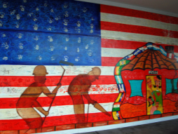
Two Growth Imperatives
Demographics
Economic
Opportunity

Slide 4
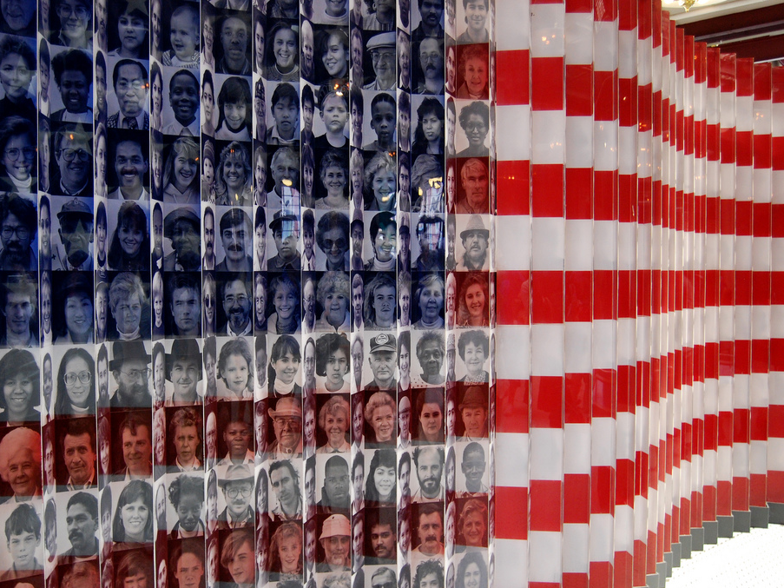
Demographics
Image Source: Ludovic Bertron. “Ellis Island” https://www.flickr.com/photos/23912576@N05/

Slide 5
The U.S. Hispanic Population Has Exploded Over the Last 60 Years
Total Hispanic Population (1950-2012)
1950
3MM
1970
9MM
1990
22MM
2012
53MM
Source: U.S. Census Bureau, Historical Statistics of the United States,
American Community Survey (2012)

Slide 6
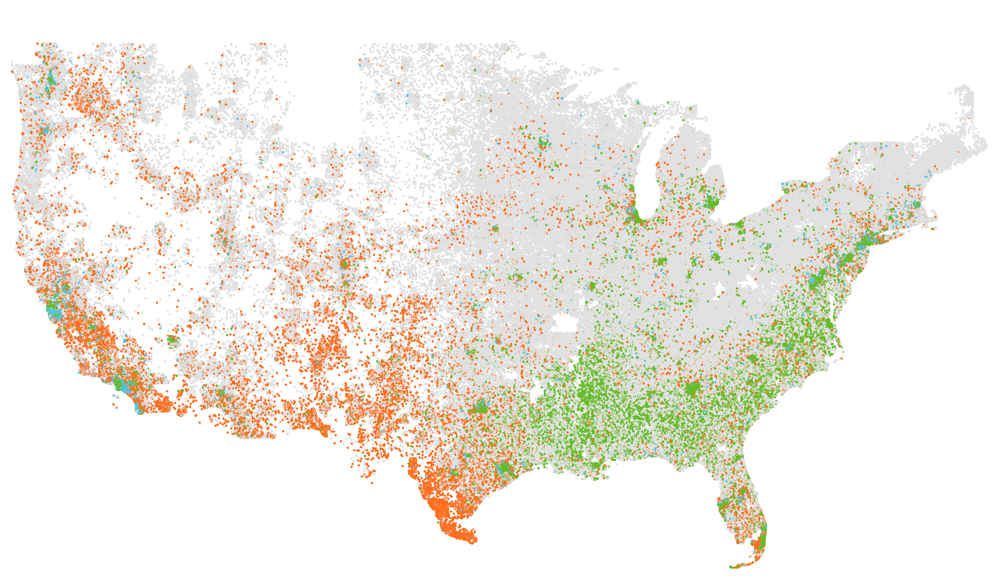
There are Currently 116MM Multicultural Consumers in the U.S.
53
MM
MM
Hispanics
314
39
MM
NH: Af-Am
16
MM
NH: Asian
197
MM
NH: White
Source: American Community Survey (2012)

Slide 7
Hispanics Added Substantially More People Than Other Multicultural Segments from 2006 to 2012
Average Persons Added Annually from 2006-2012
Hispanic
Multicultural segments added…
1,400
K
Annually
NH: African-American
NH: Asian
350
420
K
K
Annually
Annually
Source: American Community Survey (2006-12)

Slide 8
…In Fact Hispanics Drove 59% of U.S. Population Growth from 2006 to 2012
Population Growth (2006-2012)
14.5
MM
Population Growth From 2006-2012
59%
Of the 14.5MM population growth from 2006 to 2012 came from U.S. Hispanics
8.6
MM
0.9
2.1
MM
MM
2.5
MM
2.1
MM
NH: Af-Am
NH: Asian
NH: Other
NH: White
Hispanic
Source: American Community Survey (2006 & 2012)

Slide 9
Who Are the 53 Million Hispanics?
74%
Of Hispanics
(age 5+) speak Spanish at home
27
Median Hispanic age (non-Hispanic: 40)
MM
53
53%
Of Hispanic households have children (non-Hispanic: 30%)
55%
Of Hispanics live in 3 states: CA, TX, & FL
22%
Of high school students are Hispanic
Source: American Community Survey (2012)

Slide 10












Mexicans and Puerto Ricans Account for ~75% of U.S. Hispanics… But It’s Still a Diverse Group
Top Hispanic Origin Groups (2012)
MM
53
Top Countries of Origin
Mexican | 34.0M | 64.2%
Puerto Rican | 4.9M | 9.3%
Cuban | 2.0M | 3.7%
Salvadoran | 2.0M | 3.7%
Dominican | 1.6M | 3.1%
Guatemalan | 1.3M | 2.4%
Colombian | 1.1M | 2.0%
Honduran | 0.8M | 1.5%
Spaniard | 0.7M | 1.4%
Ecuadorian | 0.7M | 1.3%
Peruvian | 0.6M | 1.1%
Top Origin Regions
Mexican | 34.0M | 64.2%
Caribbean | 8.6M | 16.2%
Central Am. | 5.8M | 9.0%
South Am. | 3.2M | 6.0%
Other | 2.5M | 4.6%
Source: American Community Survey (2012)

Slide 11
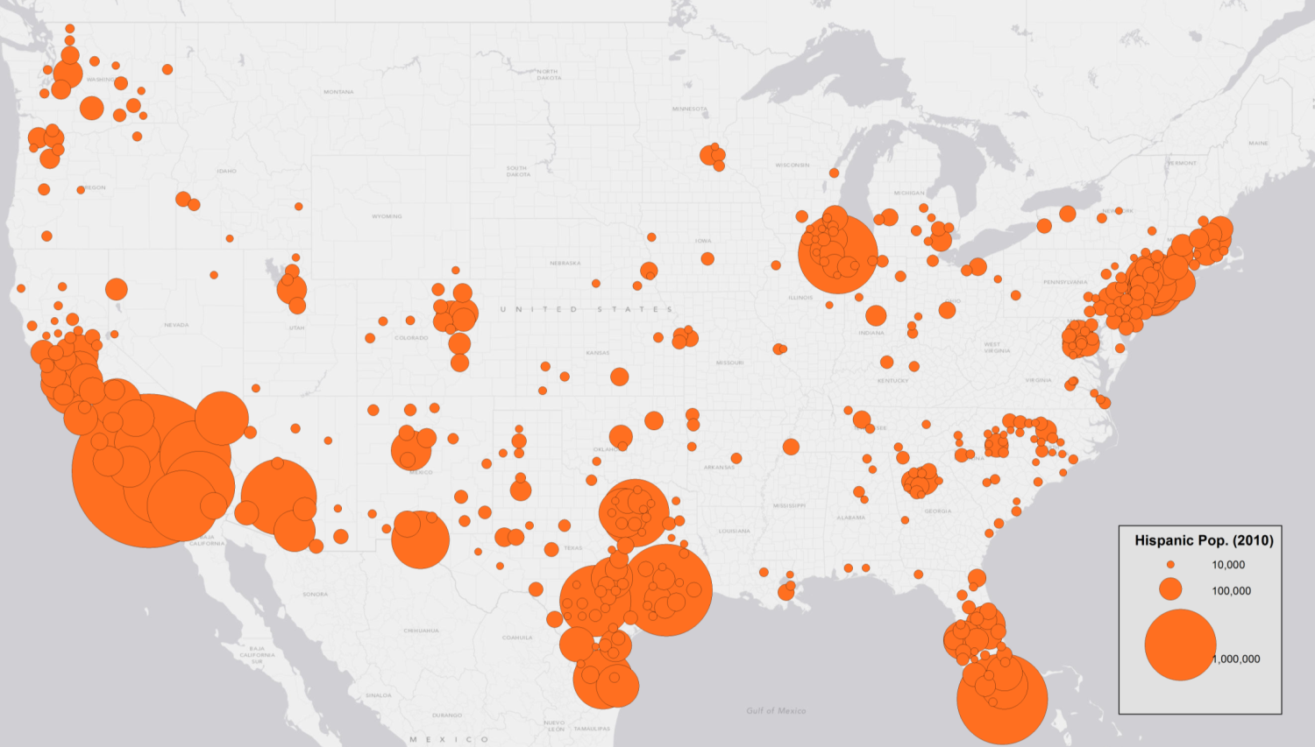
The Hispanic Population is Concentrated in Five Areas Throughout the U.S.
Hispanic Population by County (2010)
30%
Of Hispanics live in the top ten “Hispanic” counties, relative to 10% of non-Hispanics
Source: U.S. Decennial Census (2010)

Slide 12
Hispanic Population Growth Fueled by Native-Born Citizens
Nativity of Hispanics in the U.S. (2006-2012)
Current Population (2012)
Growth (2006-12)
87%
The share of Hispanic population growth attributable to native born Hispanics
64%
Of U.S. Hispanics are native born
Source: American Community Survey (2006 & 2012)

Slide 13
Age Is One of the Most Important Attributes to Understand for Hispanic Consumers
Non-Hispanic & Hispanic Age Distributions (2012)
Non-Hispanic
Median Age 40
1%
Hispanic
Median Age 27
Age Groupings
3%
53%
Of Hispanics are under 30 (compared to 38% of non-Hispanics)
6%
11%
15%
14%
12%
13%
Youth Boom
13%
12%
Source: American Community Survey (2012)

Slide 14
The Hispanic Population Will Continue to Grow Rapidly
Population Projections (2012-2025)
NH-White
2012 – 197MM
2025 – 197MM
Projected CAGR* – 0.0%
Hispanic
2012 – 52.9MM
2025 – 67.7MM
Projected CAGR – 1.9%
NH-Asian
2012 – 15.9MM
2025 – 21.2MM
Projected CAGR – 2.3%
NH-African-American
2012 – 39.5MM
2025 – 42.6MM
Projected CAGR – 0.8%
Source: Latinum Population Dynamics Model
*CAGR = Compound Annual Growth Rate

Slide 15
Multicultural Segments Will Power Future Population Growth
Projected Population Growth (2012 to 2025)
Hispanic
NH: Asian
+14.8
MM
NH: Af-Am
+5.3
MM
NH: Other
+4.1
MM
+1.6
MM
Compared to a 720K decrease in the non-Hispanic White population

Slide 16
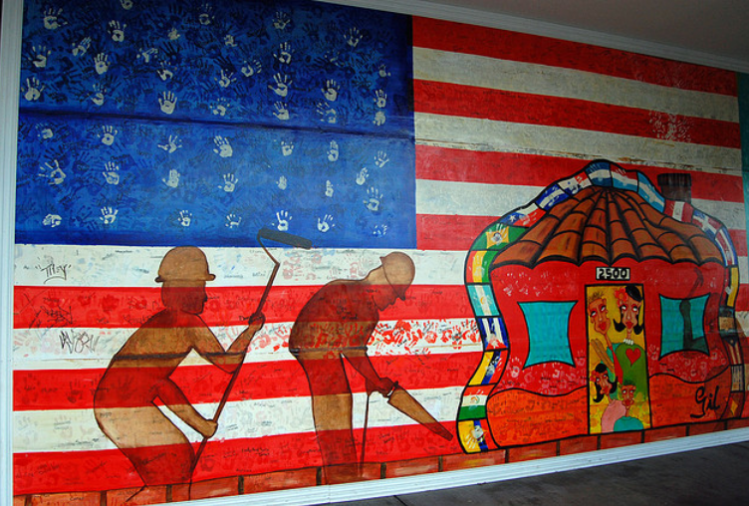
Economic Opportunity
Image Source: James Willamor. “Edwin Gil's mural, Charlotte” https://www.flickr.com/photos/bz3rk/3672093315/

Slide 17
Two Sides of the Economic Opportunity
Hispanic consumer economic standing in the U.S. breaks down into two parts…
How much money do Hispanics have to spend?
How do Hispanics spend their money, and will that grow in the future?
Income
Expenditures

Slide 18
Hispanic Household Incomes Today are Generally Lower than non-Hispanics’
Income
Hispanic and Non-Hispanic Median HH Income (2012)
Hispanic
Non-Hispanic
$40,400
$53,000
But remember Hispanics are younger, meaning they are more likely to be…
-Before peak earnings potential
Bright Future
-Native born
-Higher education levels
Source: American Community Survey (2012)

Slide 19
Hispanics Have the Greatest Purchasing Power of Multicultural Segments Despite Lower HH Income Levels
Income
Purchasing Power (2012)
Real Purchasing Power Growth CAGR (2003-12)
$1.2
0%
1%
2%
3%
4%
5%
Hispanic
T
3.9%
$1.0
NH: Af-Am
T
2.2%
$700
NH: Asian
B
4.4%
NH: White
$9.2
T
1.5%
Source: Bureau of Economic Analysis, Current Population Survey, Latinum Network Analysis

Slide 20





U.S. Hispanics as a Group Have Similar Purchasing Power to the GDP of Mexico
Income
Top Countries by GDP (2012)
Purchasing Power (2012)
Closest Equivalent GDP Country
U.S. Multicultural
≈
Germany
Country | GDP (2012)
United States | $16.2T
China | $8.2T
Japan | $6.0T
Germany | $3.4T
France | $2.6T
United Kingdom | $2.5T
Brazil | $2.3T
Russian Federation | $2.0T
Italy | $2.0T
India | $1.8T
Canada | $1.8T
Australia | $1.5T
Spain | $1.3T
Mexico | $1.2T
South Korea | $1.1T
Indonesia | $0.9T
Turkey | $0.8T
Netherlands | $0.8T
Saudi Arabia | $0.7T
Switzerland | $0.6T
$3.2
$3.4
T
T
U.S. Hispanic
≈
Mexico
$1.2
$1.2
T
T
U.S. NH: Af-Am
≈
South Korea
$1.0
$1.1
T
T
U.S. NH: Asian
≈
Saudi Arabia
$700
$770
B
B
Source: Bureau of Economic Analysis, Current Population Survey, World Bank, Latinum Network Analysis

Slide 21
What Effect Will Closing the Income Gap Have on Aggregate Purchasing Power?
Income
Income Gap Closure’s Effect on Purchasing Power
Income Gap Decrease Percent
Purchasing Power Increase
$75B
The increase in purchasing power for every 25% Hispanics close the Hispanic / non-Hispanic income gap
25%
+$75B
50%
+$150B
100%
+$300B
Source: Bureau of Economic Analysis, Current Population Survey, Latinum Network Analysis

Slide 22
On The Spend Side, Hispanics Have Seen Rapid Total Expenditures Growth
Expenditures
Real Total Expenditures (2002-2012)
CAGR Rank (2002-2012)
4.2%
NH: Asian
4%
3.6%
Hispanic
3%
2%
1.6%
NH: Af-Am
Total
0.9%
1%
0.3%
NH: White
0%
Source: Consumer Expenditure Survey (CE) 2002-2012

Slide 23
Hispanics Drove 38% of Real Total Expenditures Growth in the Past Decade
Expenditures
Share of Real Total Expenditures Growth (2002-2012)
38%
of the $584 billion in Real Total Expenditures Growth from 2002 to 2012
Source: Consumer Expenditure Survey (CE) 2002-2012

Slide 24
Hispanics Were Responsible for $224B of “Real Additive Growth” Across Industries
Expenditures
Industry Level Growth (2002-2012)
 | Total Growth
Entertainment | $68.9B
Housing | $262.2B
Healthcare | $59.9B
Personal Care | $6.7B
Education | $5.5B
Apparel and Services | $16.6B
Food | $26.9B
Transportation | -$117.3B
Total | $584.6B
Total Growth without Hispanic | Hispanic “Real Additive Growth”
$58.5B | $10.4B
$171.2B | $91.0B
$49.6B | $10.3B
$3.6B | $3.1B
$6.5B | -$1.0B
$5.9B | $10.7B
-$3.7B | $30.5B
-$147.6B | $30.2B
$360.9B | $223.7B
Many weaker performing industries would have seen far less growth or even contraction from 2002 to 2012 without Hispanic consumers’ contribution
*Total uses an overall CPI adjustment and includes unlisted industries (Cash Contributions, Personal Insurance and Pensions, & Miscellaneous) that did not have industry specific CPI adjustments
Source: Consumer Expenditure Survey (CE) 2002-2012

Slide 25


This Is Not Just Theory—Companies Find Growth with Hispanic Consumers
Expenditures
Automotive
Food
“
“
Last year, Hispanic
sales of the Nissan Sentra… accounted for 48% of that vehicle's sales growth.
-Ad Age
100% of Post's
Honey Bunches of Oats sales growth [is] from Hispanics.
-Univision on behalf of Post
”
”

Slide 26
Will “The Big Shift” Continue?
Expenditures
We looked out 15 years and considered the following factors:
1
2
Household Growth
Average Household Spend Growth
Future Total Expenditures
Scenario 1: No real growth
Static Economy
3 divergent future “demand” states of the economy
Scenario 2: Median growth
Median Economy
Scenario 3: High growth
“Best” Economy

Slide 27
Multicultural Could Represent ~33%—or $2.9 Trillion—of Total Expenditures by 2027
Expenditures
Multicultural Shares of Total Market
Hispanic
2002 – 9.1%
2012 – 11.8%
2027 – 14.8% to 15.6%
11.8%
NH: Af-Am
2002 – 8.6%
2012 – 9.2%
2027 – 9.3% to 10.0%
9.1%
NH: Asian
2002 – 4.0%
2012 – 5.3%
2027 – 6.5% to 7.0%
Source: Latinum Network Analysis

Slide 28
Hispanics Will Drive Substantial Growth Across All Potential Future Scenarios
Expenditures
Multicultural CAGRs
Share of Total Expend Growth (12-27)
2027 Economy State
Static Economy
$730 billion increase from 2012
45% of Total Expenditures growth from
Hispanics
 | Proj. CAGR (12-27)
NH: White | 0.2%
Hispanic | 2.5%
NH: Af-Am | 1.2%
NH: Asian | 2.0%
NH: Other | 3.5%
NH: Other
NH: Asian
NH: White
NH: Af-Am
Hispanic
Median Economy
$1.2 trillion increase from 2012
31% of Total Expenditures growth from
Hispanics
 | Proj. CAGR (12-27)
NH: White | 0.6%
Hispanic | 2.7%
NH: Af-Am | 1.6%
NH: Asian | 2.5%
NH: Other | 3.5%
NH: Other
NH: Asian
NH: Af-Am
NH: White
Hispanic
“Best” Economy
$2.4 trillion increase from 2012
26% of Total Expenditures growth from
Hispanics
 | Proj. CAGR (12-27)
NH: White | 1.6%
Hispanic | 4.1%
NH: Af-Am | 2.2%
NH: Asian | 4.1%
NH: Other | 4.7%
NH: Asian
NH: Other
NH: Af-Am
Hispanic
NH: White
Source: Latinum Network Analysis

Slide 29
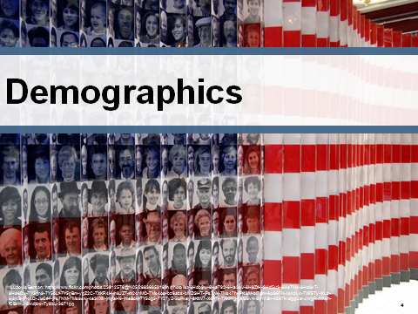
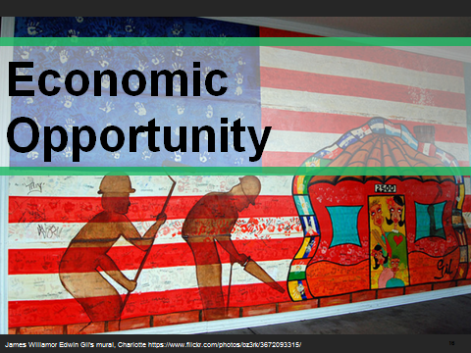
In Conclusion
U.S. Hispanics are:
Powered by favorable demographics
&
Driving economic growth now and into the future

